Slide 1
ESPQS Section 100
Intro to Scientific Argumentation (CER), "My Dad is a Space Alien"

Slide 2
Scientific Argumentation and Explanation
Warm-up
On a sheet of paper, answer the following:
What three words do the letters “CER” stand for?
Write a short description of what each word means.

Slide 3
Scientific Argumentation and Explanation
(Claim – Evidence – Reasoning)
"My Dad is a Space Alien"

Slide 4
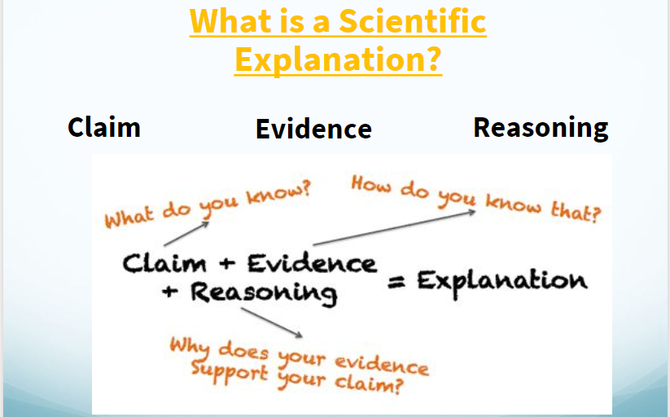

Slide 5
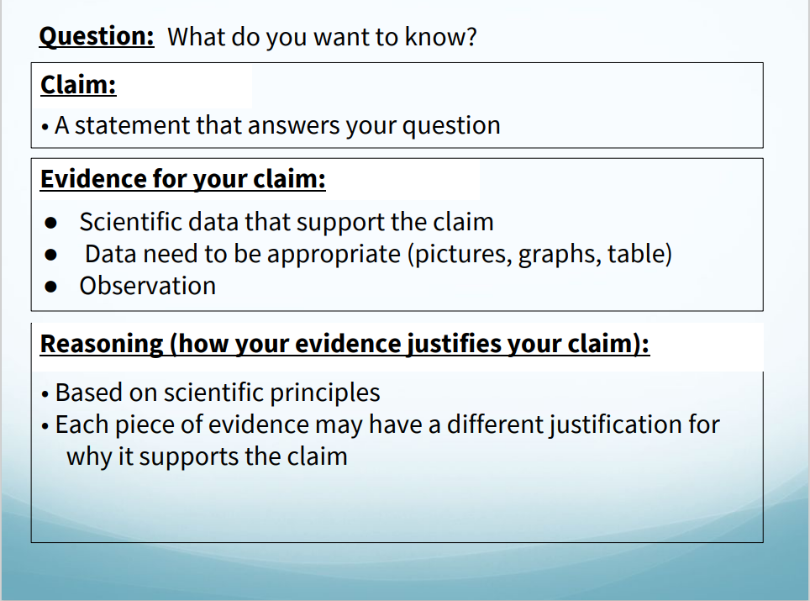

Slide 6
Argumentation and CERs in Class
When? We use CER-based narratives after completing a lesson.
Why? CER-based narratives allow you to make connections between the lesson and the lab. Also, learning how to write in science is very important to your education as a whole.
How? CER-based narratives are set up in a paragraph form (usually 5-7 sentences in length). There are times when it is necessary to include a data table, graph, or picture in with your evidence.
They are used in REAL LIFE!

Slide 7
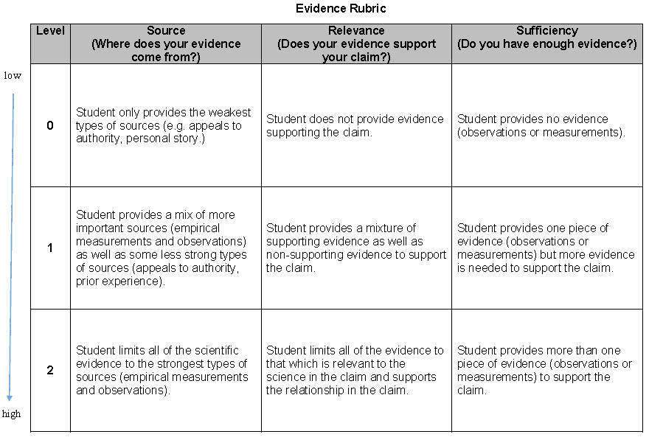
Evidence Rubric

Slide 8
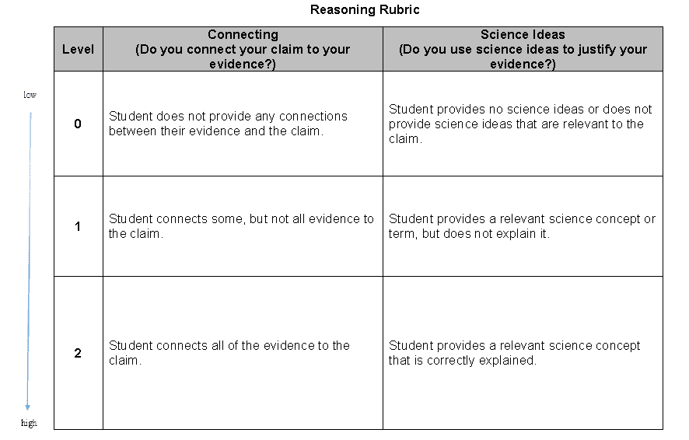
Reasoning Rubric

Slide 9
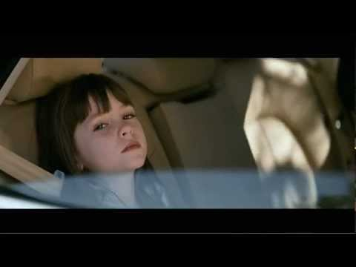
youtube my dad is a space alien
https://www.youtube.com/watch?v=WQTsue0lKBk

Slide 10
The "Evidence" doesn't lie? - Evaluation
I have evidence that proves my Dad’s a space alien.
He speaks a weird language.
He drinks green stuff.
He says he’s from Albuquerque, I’m not buying it.
I mean, just look at him. (Walks by in weird clothes.)
And one more thing...He has a space ship.
The evidence doesn’t lie.
My dad’s an alien.
Notes:
Teacher facilitates online or on screen discussion (or after breakout groups) to determine whether a line is Evidence, Reasoning, or something else.

Slide 11
Claim: "My Dad is a Space Alien."
Evidence ("My Dad...")
Reasoning ("Aliens...")
He speaks a weird language
He drinks green stuff
He dresses in a weird suit
He has a spaceship
He's from Alburquerque ?
They come from a different world with an alternative language
They eat differently from humans
They don’t dress like humans do and need protection in space
They require a form of space travel
Area 51 is in New Mexico

Slide 12
Explanation - Pulling it all together
My dad is an alien.
Aliens speak a weird language, drink green stuff, wear funny clothes, and they have spaceships.
My dad speaks a weird language, drinks green stuff, wears funny clothes and, finally, he has a space ship, like an alien.
Therefore, my dad is an alien.

Slide 13
Explanation - Pulling it all together
My dad is an alien.
My dad speaks a weird language, like Aliens from another planet might. He drinks green stuff and Aliens have different diets from humans. He wears funny clothes like those Aliens wear to protect them in space, and he has a spaceship, like Aliens use to move between worlds in space.
Therefore, the evidence doesn’t lie...my dad is an alien!
Notes:
Could have students use rubrics to evaluate the passage.

Slide 14
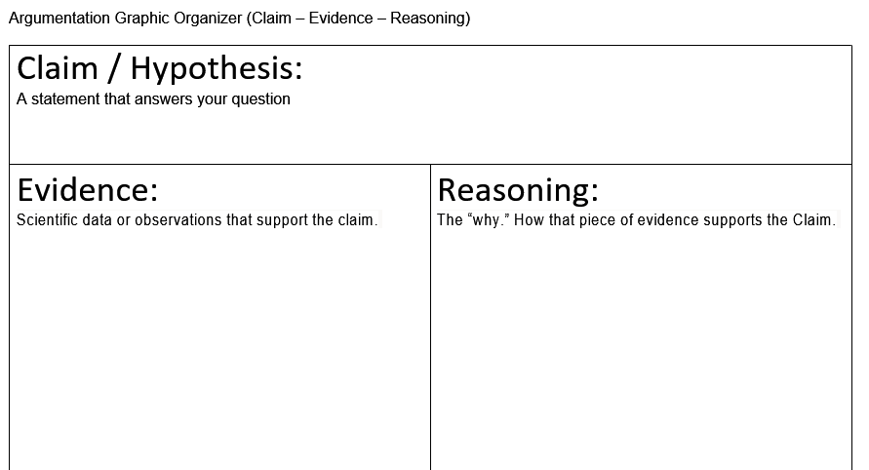
Organizer
1.
2.
3.
1.
2.
3.

Slide 15
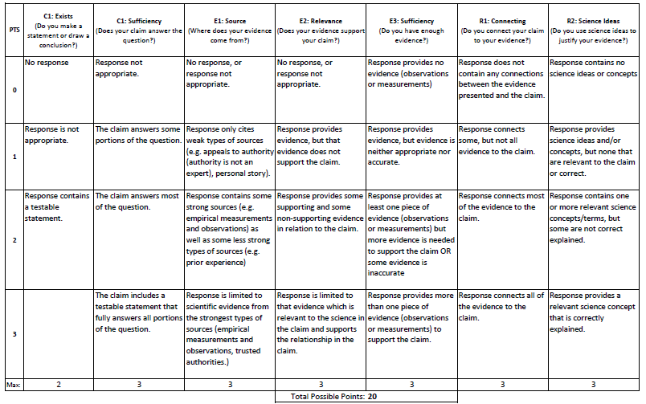
Rubric

Slide 16
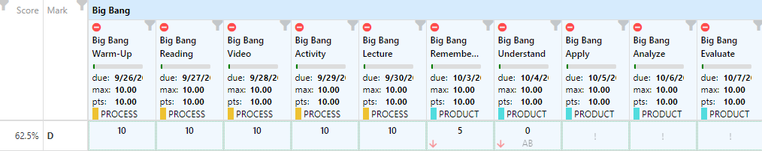
Warm-Up
This student came to the teacher and felt the grade of a 62.5% D was incorrect and was not fair. The teacher pulled up the grades (shown below). Form a CER Argument defending your claim! Is the teacher or the student correct and why?

Slide 18
Web Search
“Cheryl’s She Shed Commercial”

Slide 19
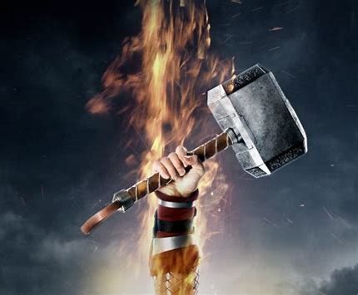
Who burned Cheryl’s She Shed
Thor burned down Cheryl’s She Shed
Thor is the God of Thunder
Thor seeks justice using violent acts
Thor has also been associated with “sacred groves and trees” (Wiki)
Lighting is what causes thunder, so Thor had to be involved as the God of Thunder as a protector of sacred groves and trees, he likely disliked the placement of the she shed, therefore he destroyed it with violence, in the form of lighting to burn Cheryls She Shed.

